Slide 1

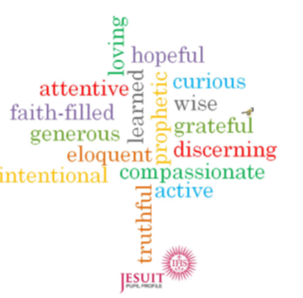
Intentional and Prophetic
My target for this half term
To be like Alad and Anya I am planning to …
What I will need to do to achieve this.
1.
2.
3.
How I know I have been successful.
1.
2.
3.
‹#›
‹#›

