Slide 1




Scripture Link
Communities First in Newport
‘Truth Eternal – (Mark 14:22-25) God’s Story 3 p.114
Achievement Twins

Slide 2




How do they help?
AchievementTwins

Slide 3

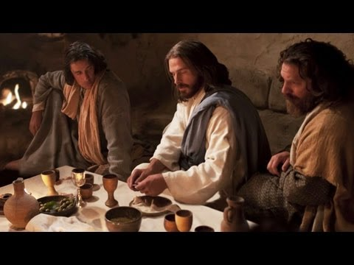

‘Truth Eternal – (Mark 14:22-25) God’s Story 3 p.114
Achievement Twins

Slide 4
Listen to the hymn. What will you do to help others? Place a
Respond

Slide 5


Show we are all one community

