Slide 1



Scripture Link
St. David’s National Awards 2021
You are a Holy People - Colossians 3: 12-17 God’s Story 3 p 147
Achievement Twins

Slide 2
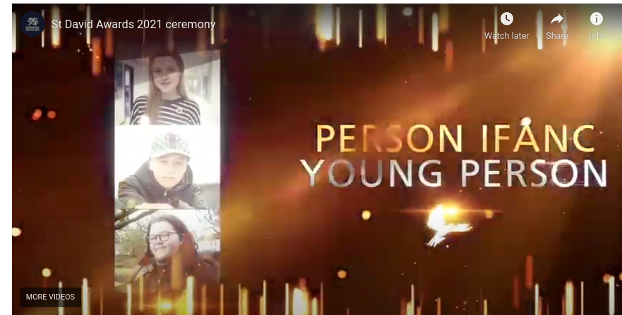

St. David’s Awards 2021
https://gov.wales/st-david-awards/2021-awards
We are going to click on the link and find out about the awards and one of the people nominated - Ethan Hutchings.
AchievementTwins

Slide 3

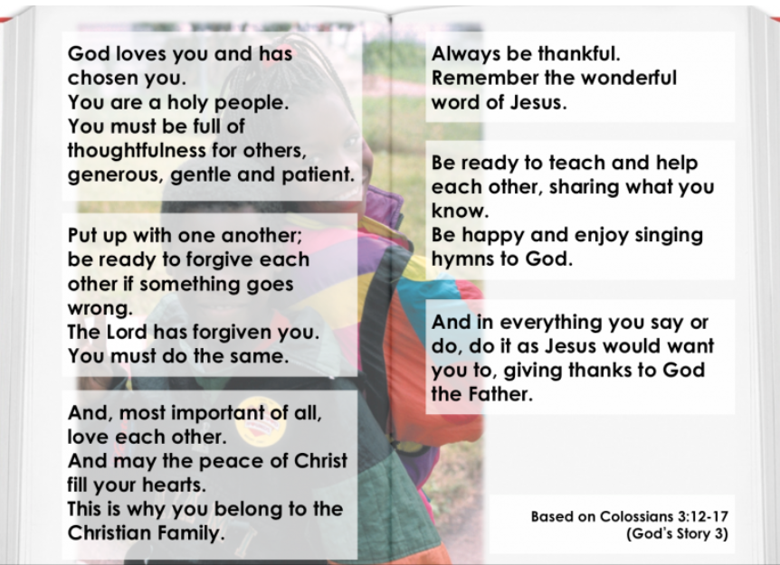

You are a Holy People - Colossians 3: 12-17 God’s Story 3 p 147
Achievement Twins

Slide 4
Close your eyes for a moment. What will you do to help others?
Respond

Slide 5


Being a Holy People

Slide 6
Now to work. In your topic books can you think about being generous, gentle and patient. If you were going to give an award to someone about this, who would it be and why?
Imagine you are nominating them for the St. David’s Awards. Explain why you are nominating them and why. Can you design an award for someone who is generous, gentle and patient?

