Slide 1
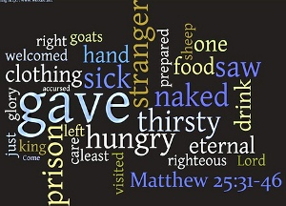


Scripture Link
Helping those in need – St. David’s Foundation
‘When you do this to your brothers and sisters’ – (Matthew 25:31-40) God’s Story 3 p.88
Achievement Twins

Slide 2
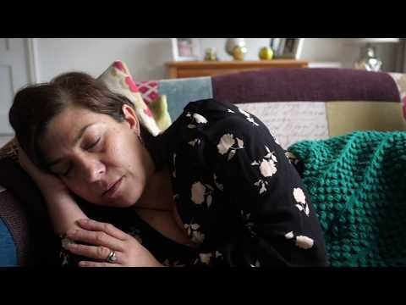

Think about how they help.
AchievementTwins

Slide 3

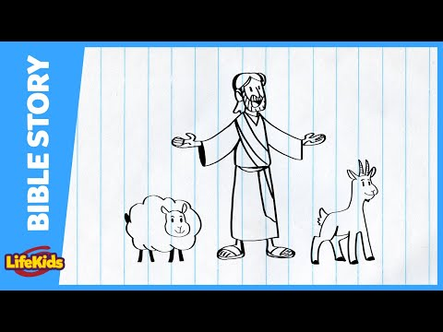

‘When you do this to your brothers and sisters’ – (Matthew 25:31-40) God’s Story 3 p.88
Achievement Twins

Slide 4
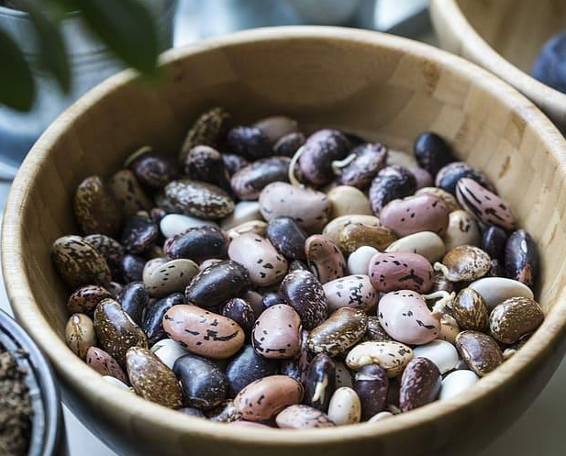

Place a pebble on the altar, think about how you will help others.
Respond

Slide 5


Use your gifts to help others

