Slide 1

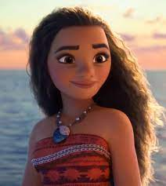

Scripture Link
Mission to Help - Moana
‘Sharing the Mission’ – (Acts 6:2-13, 7:57-60) God’s Story 3 p.137
Intentional and Prophetic
Achievement Twins

Slide 2
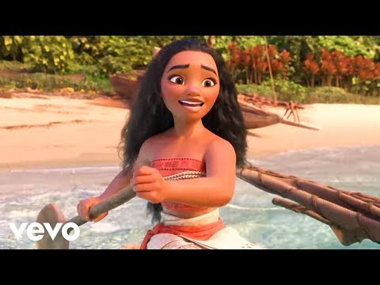

How you got a mission? What is Moana’s?
AchievementTwins

Slide 3


‘Sharing the Mission’ – (Acts 6:2-13, 7:57-60) God’s Story 3 p.137
Achievement Twins

Slide 4

Listen to the quiet music. How might you spread the Good News?
Respond

Slide 5


Spread God’s Good News

