Slide 1
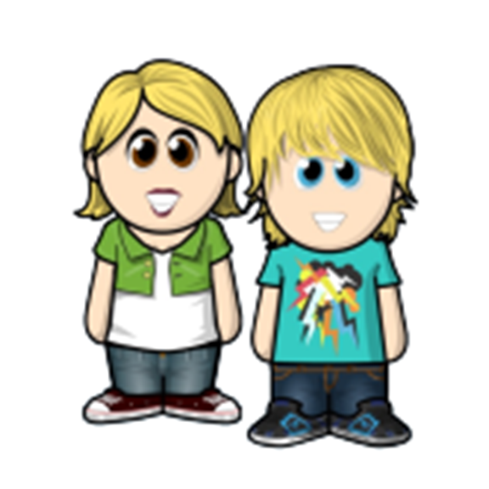

Dewi’s Dream Team – Adventures in St. David’s Primary
The Achievement Twins – Prize Day

Slide 2
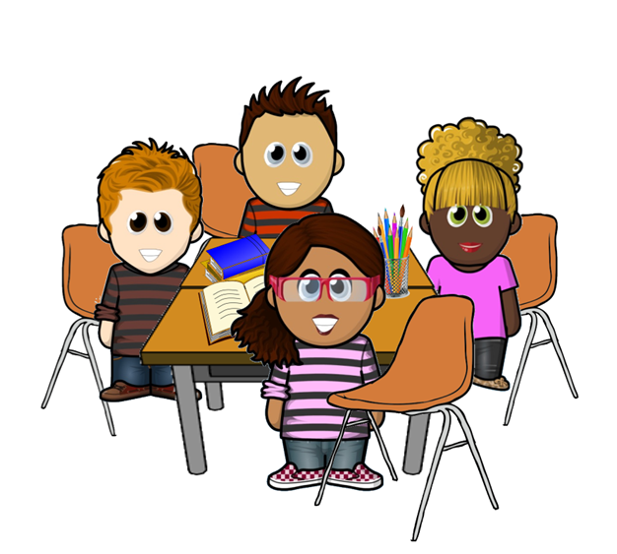

Dewi’s Dream Team – Adventures in St. David’s Primary
It was nearly the end of the school year. The class were getting very excited about the upcoming prize day that Y6 were going to be doing with Mr. James.
They sat talking about who they thought would win the class prizes that year. Secretly though, none of the friends thought they were going to win anything. When the bell rang, they all went away feeling very sad.

Slide 3
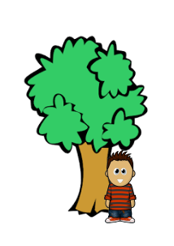
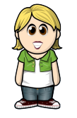
Dewi’s Dream Team – Adventures in St. David’s Primary
At playtime, Pete sat by the tree feeling very gloomy. Aled and Anya, the achievement twins, saw him sitting by himself. They came over to see what was wrong.
“Hi Pete, what is the matter?” asked Anya.

Slide 4
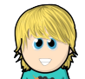
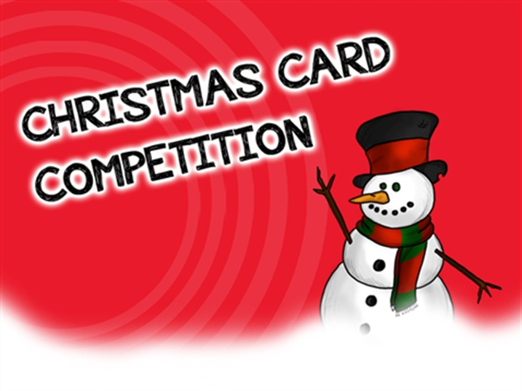
Dewi’s Dream Team – Adventures in St. David’s Primary
“I am never going to win anything on prize day” replied Pete sadly. “ I never win anything!”
But you are great at art!
“ But what about your Christmas card?” asked Aled. “ The other classes were talking about it for ages, It was so big!!”

Slide 5
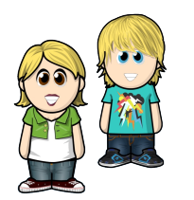
Dewi’s Dream Team – Adventures in St. David’s Primary
Anya agreed. “ Yes. You are sure to win the Art Award.”
“Do you think so?” asked Pete happily. He grinned and went away feeling much better. The twins smiled at each other.

Slide 6
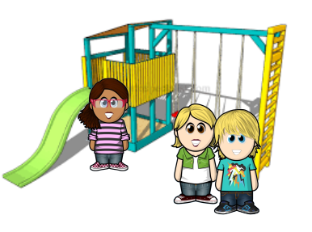
Dewi’s Dream Team – Adventures in St. David’s Primary
The next playtime, Aled and Anya saw Cate by herself on the playground. She looked as if she had been crying.
“What is the matter?” asked Aled.

Slide 7

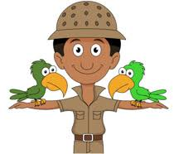
Dewi’s Dream Team – Adventures in St. David’s Primary
Cate sighed. “I am sad about Prize Day. I never win anything. I bet I don’t get anything. Everyone is better than me.”
She wiped away a tear and sat down.
The twins looked at each other. Anya sat next to her. “What about your zoo project? That was great. Everyone was talking about it in our lessons in January.” said Anya.
Aled nodded in agreement. “And we were able to talk to a wildlife reserve in Kenya – that was amazing! I heard Mrs. Jones say it was the best project she had ever seen. You are bound to win the Project Award.”

Slide 8
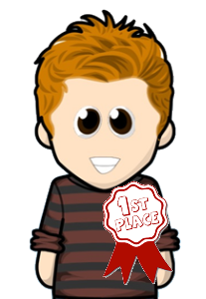
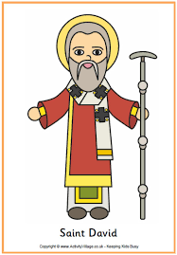
Dewi’s Dream Team – Adventures in St. David’s Primary
The next day the same thing happened with Norman and Cara.
The twins reminded Norman of his amazing Eisteddfod work.
Aled was sure his entry would win the Cymraeg Award.

Slide 9
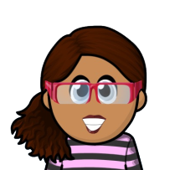
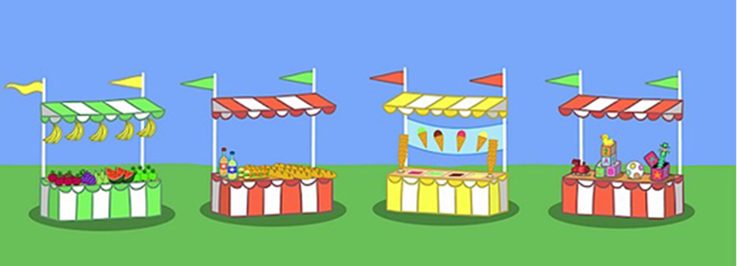
Dewi’s Dream Team – Adventures in St. David’s Primary
Cara was also sad.
The twins reminded her of all her help in the school fete.
Anya was sure she would win the PPTA award for help to the school.

Slide 10


Dewi’s Dream Team – Adventures in St. David’s Primary
All the friends were feeling much better by the morning of the Prize Day assembly.
At half past nine, the bell rang and all of the children settled down to watch the assembly
The children had a lovely time. The teachers gave out class prizes, they clapped and cheered as they celebrated all the special achievements of the year and they even gave a lovely gift to Mrs Williams, who was leaving at the end of term to have a baby.

Slide 11

Dewi’s Dream Team – Adventures in St. David’s Primary
Finally it was time for the special prizes. The friends sat up – would the twins be right? They all listened carefully.
Mrs. Jones asked for quiet. There was hush up and down the corridors of the school. “The first prize, for Best artist goes to ……
Pete!”
The friends cheered loudly as Pete collected his trophy.
Page 10

Slide 12

Dewi’s Dream Team – Adventures in St. David’s Primary
The twins were right about everything. Cate won the Best Project Award.
Norman’s Welsh project was to be put on display at St. Fagan’s, and he won a free weekend pass for his family.
Cara’s efforts to fundraise for the school were so good the chair of the PPTA has designed a poster to go on the national PPTA website, and Cara had a gift voucher as well.

Slide 13

Dewi’s Dream Team – Adventures in St. David’s Primary
The twins smiled at each other. They were happy that their friends’ wonderful talents had been recognised.

Slide 14

Dewi’s Dream Team – Adventures in St. David’s Primary
Mrs Jones stood up and asked for quiet. “There is one more very special award this year.”
“The children came to see me and have bought this award with their own money to give to give to some children they think are very special.”

Slide 15
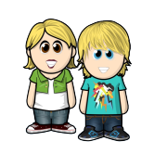
Dewi’s Dream Team – Adventures in St. David’s Primary
“This award is for someone who is a good friend, who sees how much hard work their friends do, and enjoys celebrating their achievements. This person never feels jealous of the achievements of others, but is inspired to do even better themselves by the success of their friends.”
“However, there is not one winner this year, but two. Congratulations to Aled and Anya.”
All the other children cheered in agreement. Nobody could think of more worthy winners – Aled and Anya were supportive of everyone in school.

Slide 16
Dewi’s Dream Team – Adventures in St. David’s Primary
After school the children chatted about their prizes. They all agreed that it was nice to win, but that the best prize of all was in having pride in your own achievements, knowing that you had tried your best.
The twins smiled. The only person you are ever really competing with is yourself, they both thought, and went to tell their Nan about their amazing day as she arrived to pick them up.

Slide 17
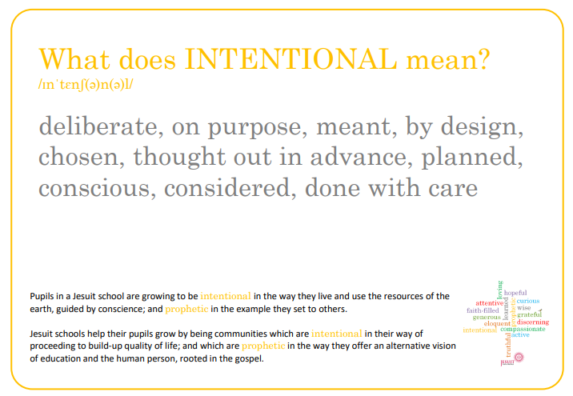
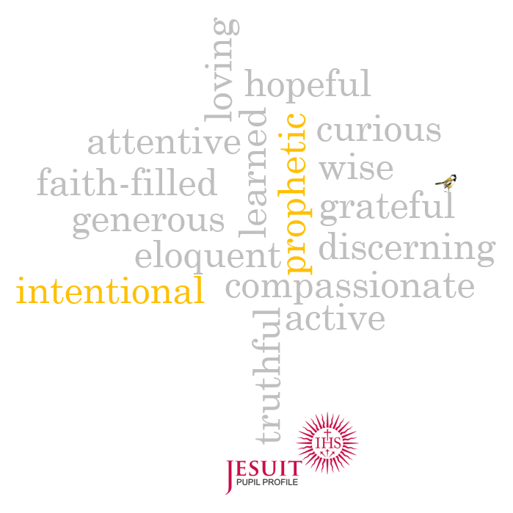
In the story Aled and Anya were intentional in the way they spoke with their friends. - what things did they do that show this?
‹#›

Slide 18
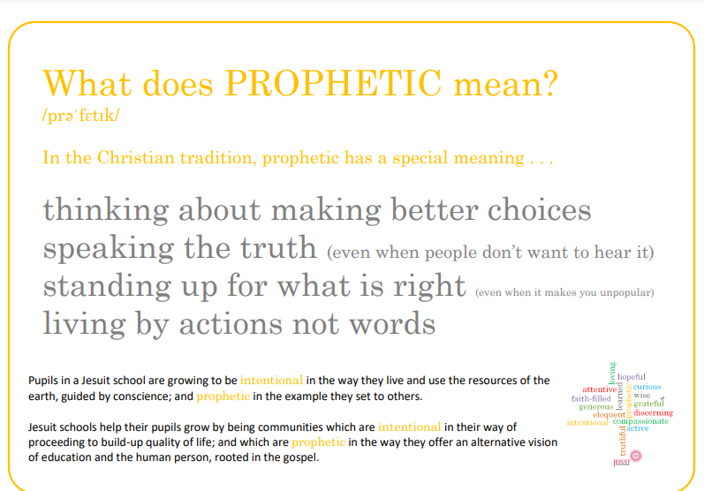
Aled and Anya have shown they are prophetic in the story - what things did they do that show this?
‹#›

Slide 19
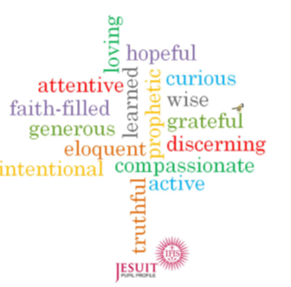
Intentional and Prophetic
My target for this half term
To be like Alad and Anya I am planning to …
What I will need to do to achieve this.
1.
2.
3.
How I know I have been successful.
1.
2.
3.
‹#›

