Slide 1
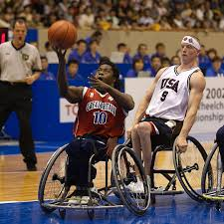
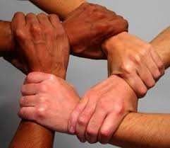
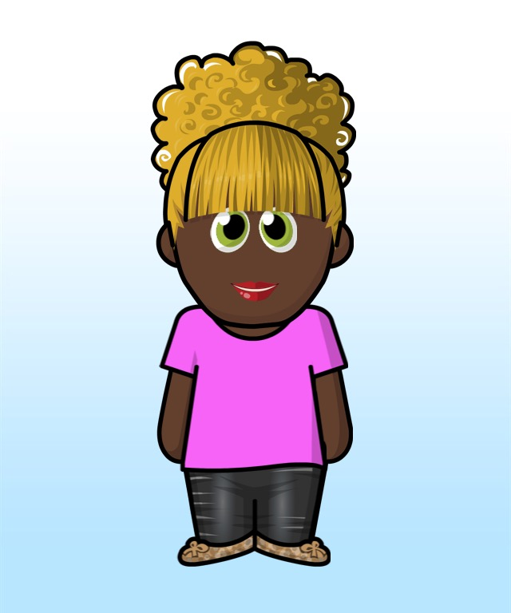
Scripture Link
‘’Living God’s Way’ – (Acts 2:43-47; 4:32-37 – God’s Story p134)
Ade Adepitan, Paralympian - “Believe in Yourself”.
curious and active
Collaboration Cara

Slide 2
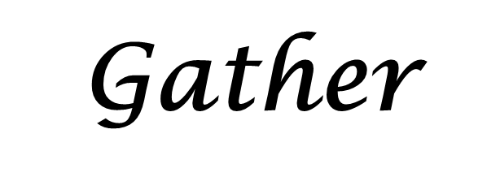

Ade Adepitan, Paralympian - “Believe in Yourself”.
https://www.bbc.co.uk/teach/class-clips-video/pshe-ks2--ks3-ade-adepitan-paralympic-champion/zbwxnrd

Slide 3
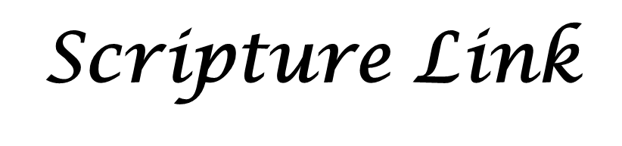

‘’Living God’s Way’ – (Acts 2:43-47; 4:32-37 – God’s Story p134)
curious and active

Slide 4

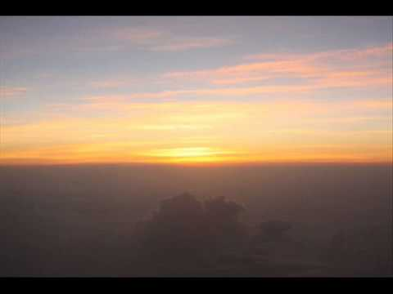
Listen to the quiet music. We need to rely on God.
Place a prayer bead by the word you think matters most.
Share
Respect
Community
Together
Respond
Collaboration Cara

Slide 5
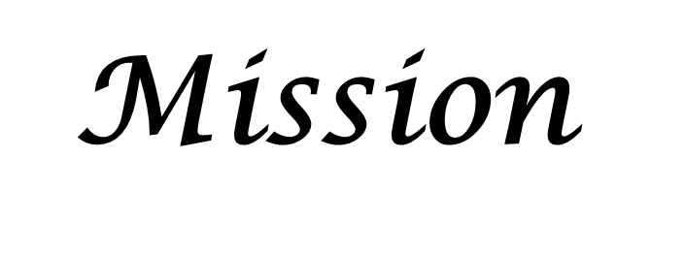
Believe, and with God’s help – together we can succeed!
curious and active

Slide 6
Think of the words- Show you believe you can be curious and active learners. Create two acrostic poems using these.
Share
Respect
Community
Together
Back in class…
Collaboration Cara

