Slide 1




Scripture Link
We can’t help everyone, but everyone can help someone
‘With God’s help’
(Luke 10:25-37)
curious and active
Collaboration Cara

Slide 2

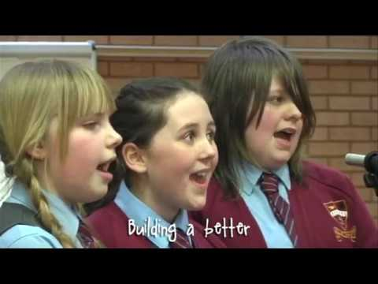

We can’t help everyone, but everyone can help someone
Collaboration Cara

Slide 3


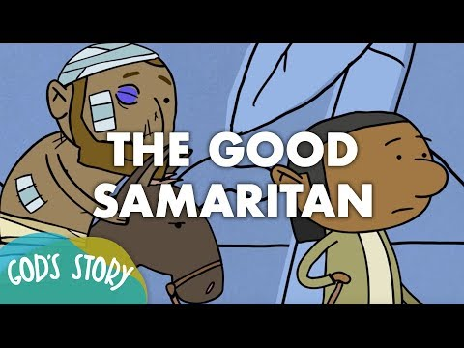
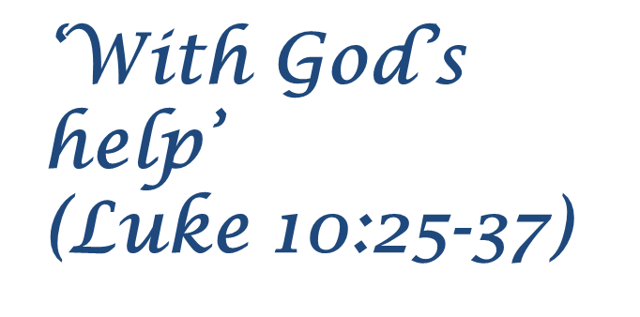

https://www.bbc.co.uk/teach/school-radio/assemblies-the-good-samaritan-modern-setting-ks2/zjsx2v4
Collaboration Cara

Slide 4
Close your eyes and tell God. How you will ‘help your neighbours around the world?’
Respond
Collaboration Cara

Slide 5

Speak and ask God for help
curious and active

