Slide 1
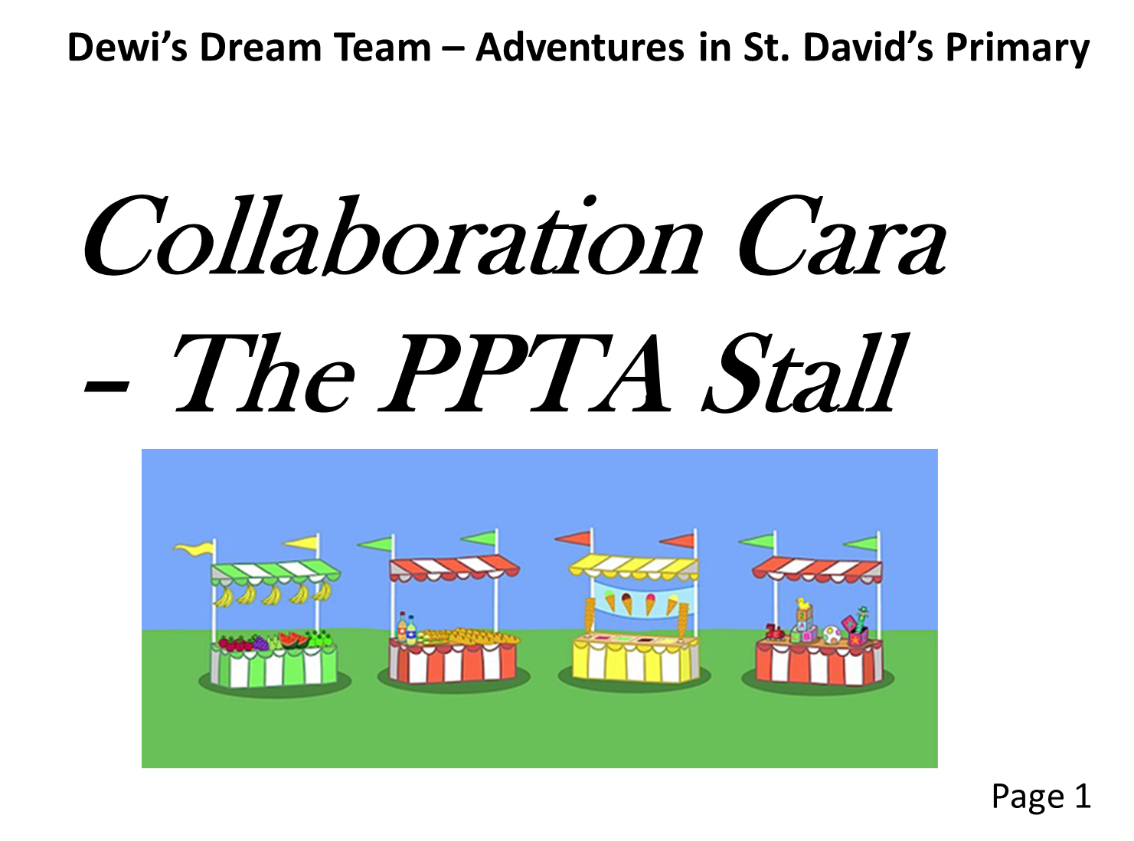

Curious and active

Slide 2
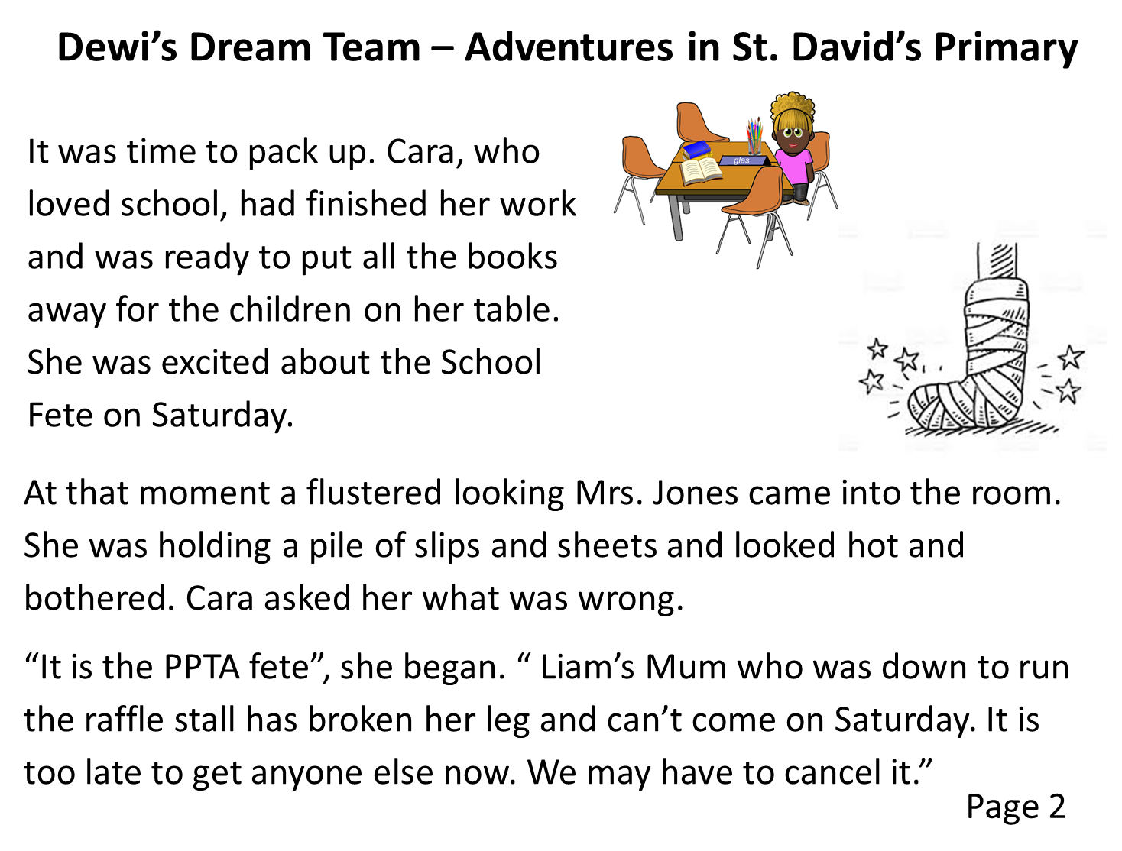

Slide 3
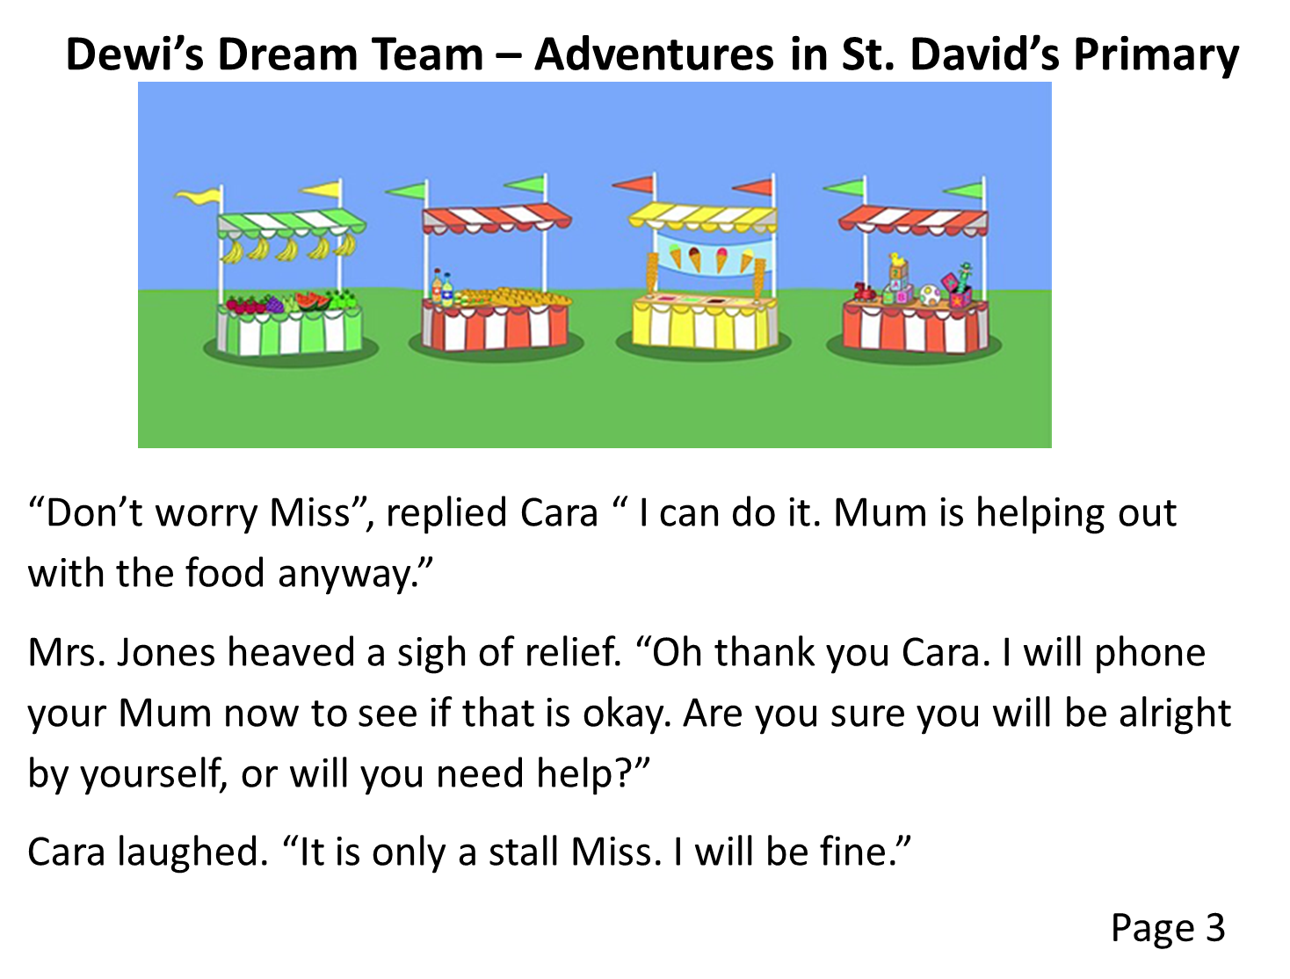

Slide 4
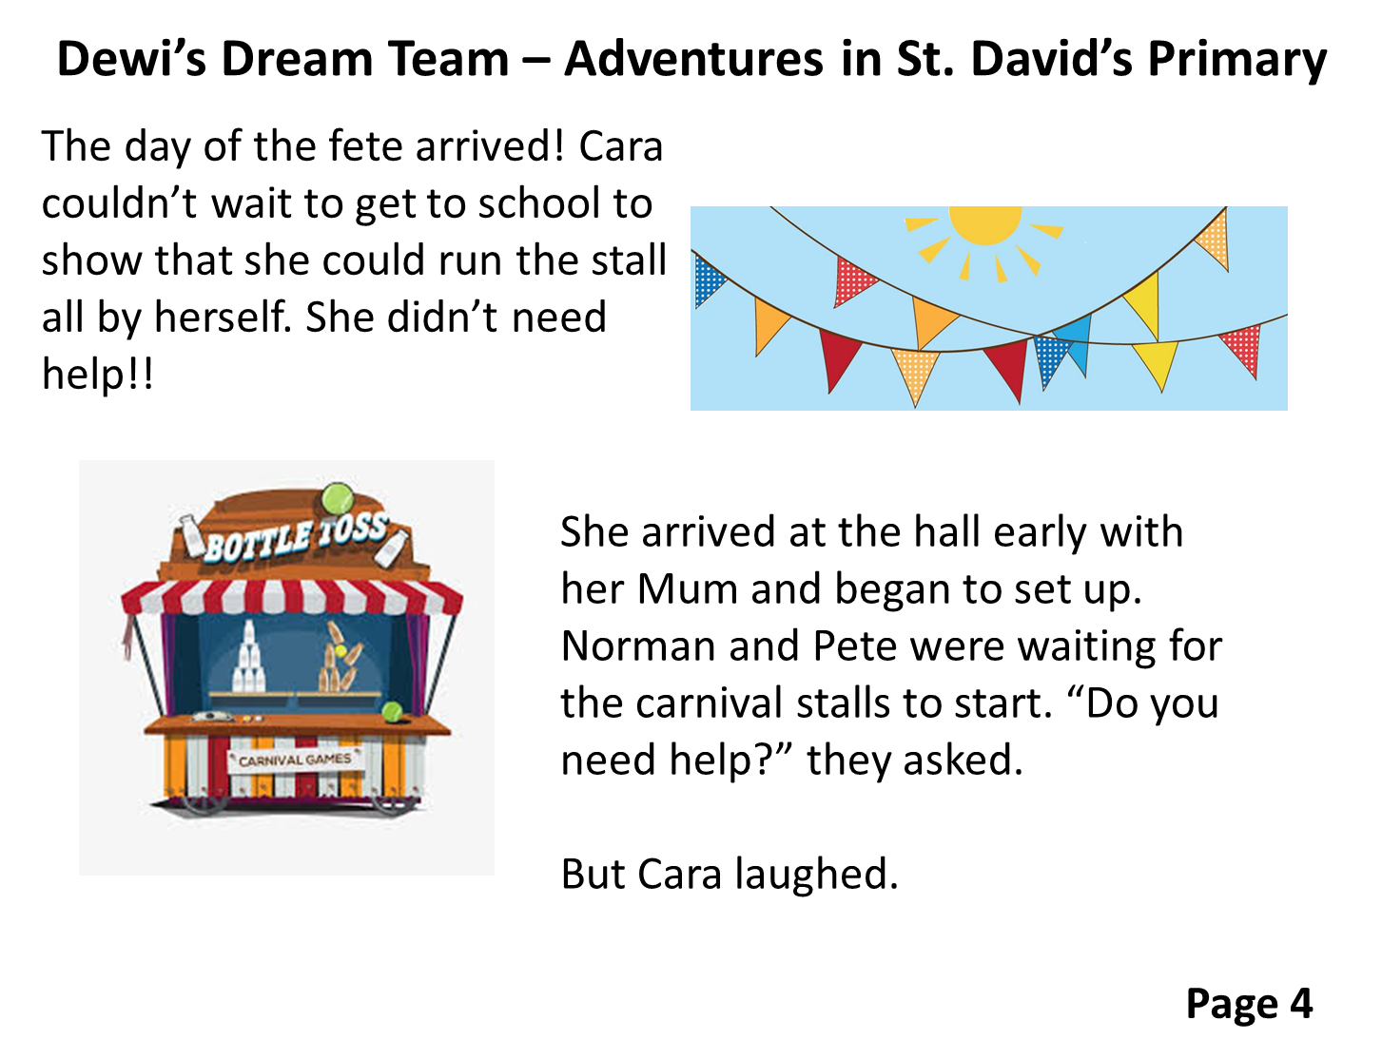

Slide 5
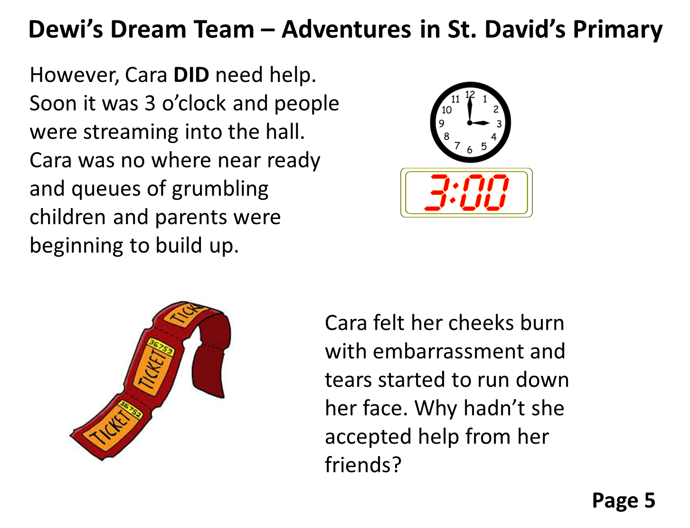

Slide 6
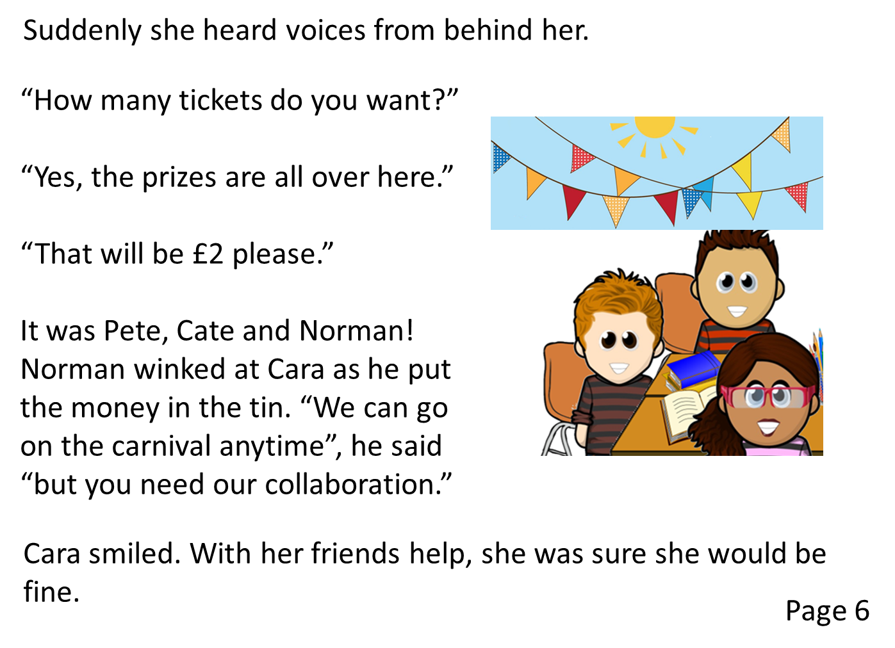

Slide 7
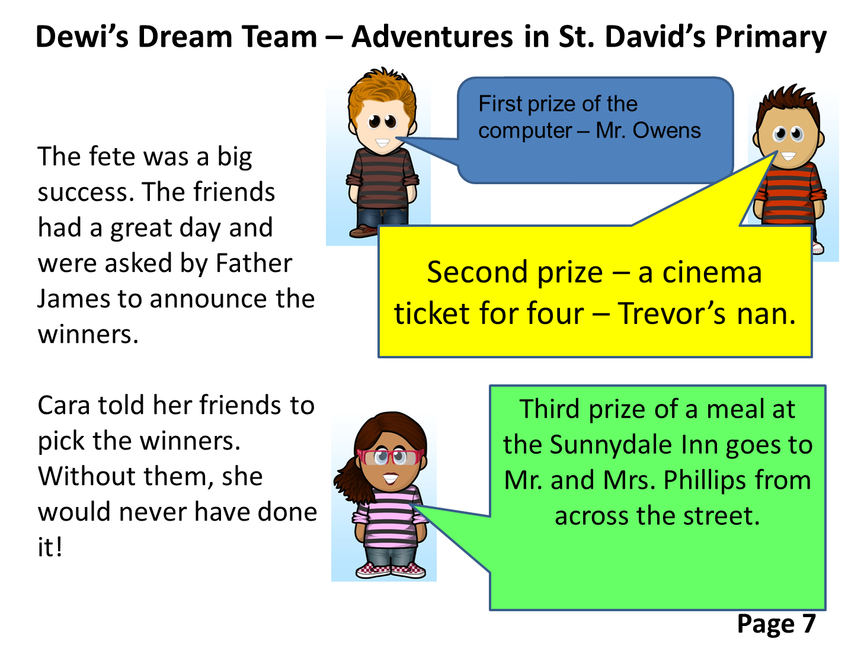

Slide 8
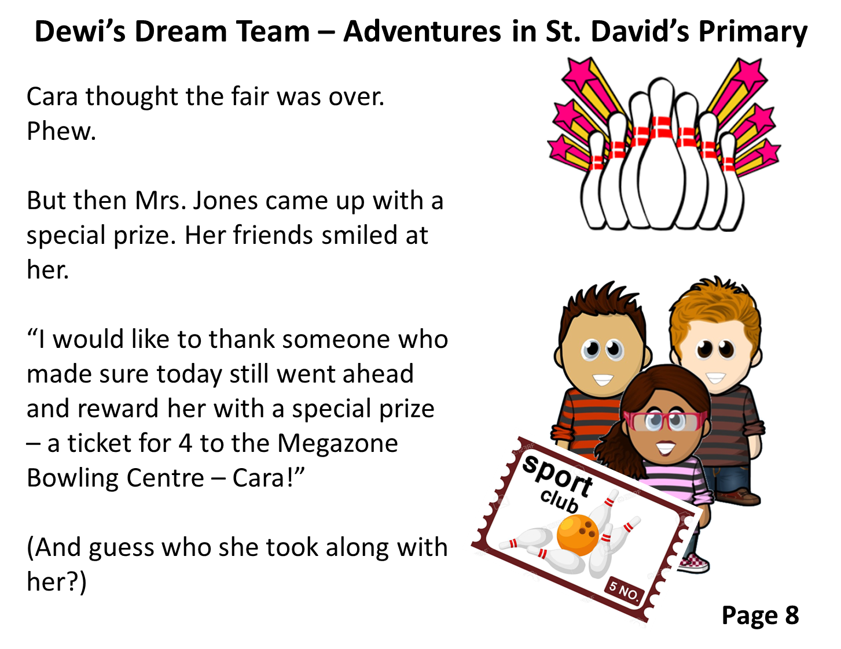

Slide 9

If we are stuck, we can always ask for God’s help.
This half term, we are thinking about being curious and active.

Slide 10
How have you been curious about your work and the world around you? How do you stop being passive? How will you be an active member of your class and school/home community?

Slide 11
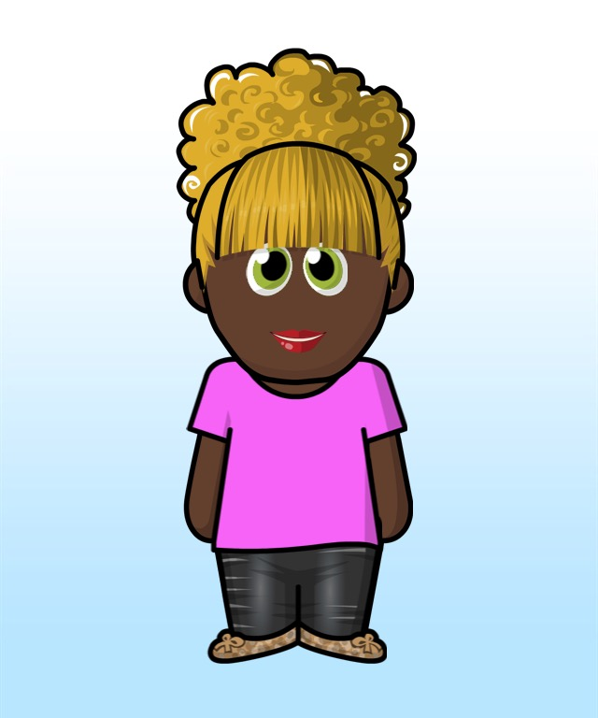
Curious and Active
My target for this half term
To be like Collaboration Cara, I am planning to …
What I will need to do to achieve this.
1.
2.
3.
How I know I have been successful.
1.
2.
3.

Slide 12
Curious and Active
My target for this half term
To be like Collaboration Cara, I am planning to …
What I will need to do to achieve this.
1.
2.
3.
How I know I have been successful.
1.
2.
3.

