Slide 1
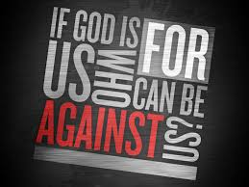


No Man is an Island – Tenth Avenue North
Scripture Link
‘God is for Us’ - (Romans 8:28, 31-32) God’s Story 3 p141
curious and active
Collaboration Cara

Slide 2




What do you think this might be about? Later in our assembly we will listen to this song.

Slide 3
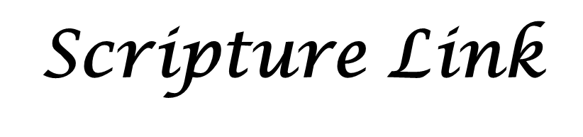


‘God is for Us’ - (Romans 8:28, 31-32) God’s Story 3 p141

Slide 4

None of us are an island – we all rely on each other. Don’t be afraid to ask for help. Let us imagine our altar is the globe with individual islands on it.
Respond
Collaboration Cara

Slide 5
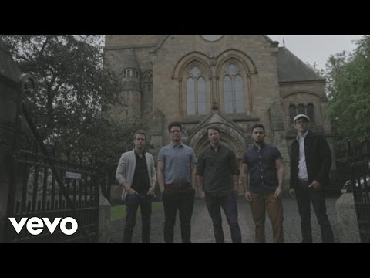

Whilst we listen to the song, decorate your ‘prayer hands’ to join up the ‘islands’ on our globe.

Slide 7
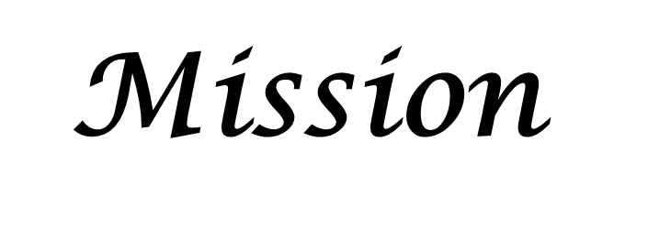
curious and active
Don’t be afraid to ask for help from God, our teachers and our friends

