Slide 1
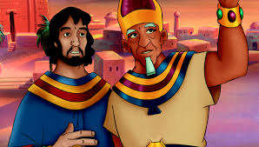

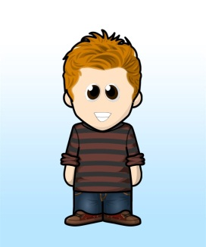
Scripture Link
‘The Serenity Prayer
‘Being Wise’ – Joseph in Egypt (Genesis 39:1-4 and 41:38-48,57)
God’s Story 3 p.16
Knowing Norman

Slide 2
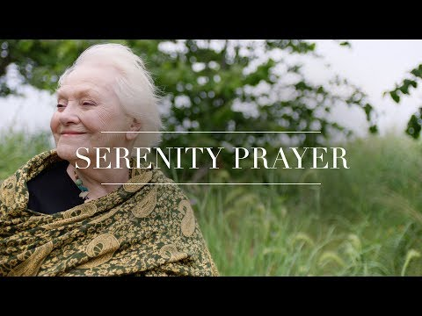
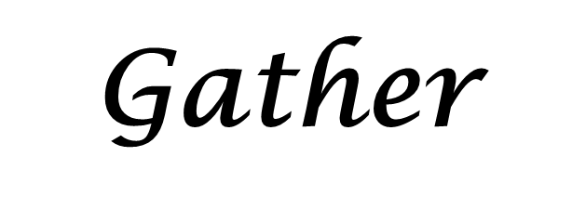
Serenity
Courage
Wisdom
Knowing Norman

Slide 3
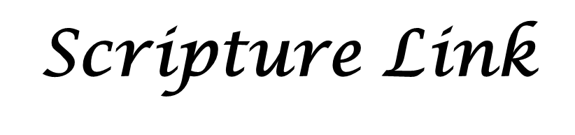
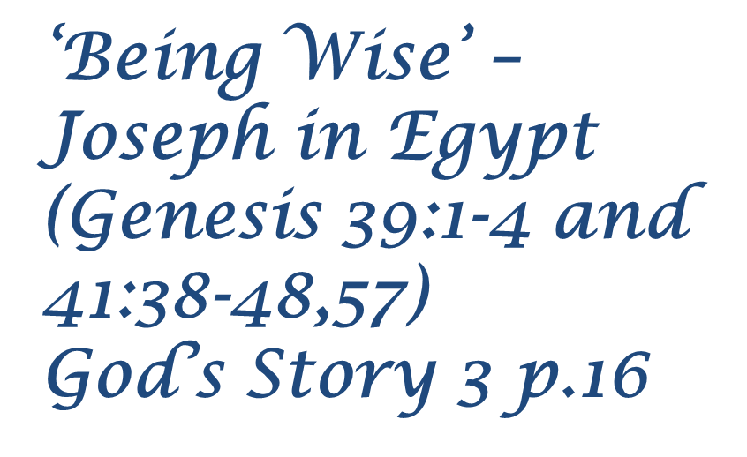
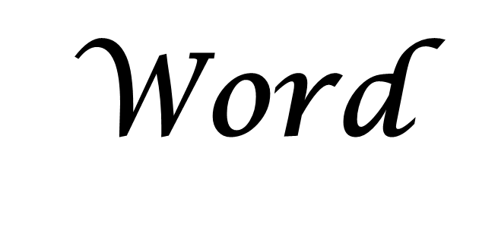
Let us join our hands as we read God’s Words.
A reading from the Book of Genesis
The Word of the Lord
All- Thanks be to God.
Knowing Norman

Slide 4
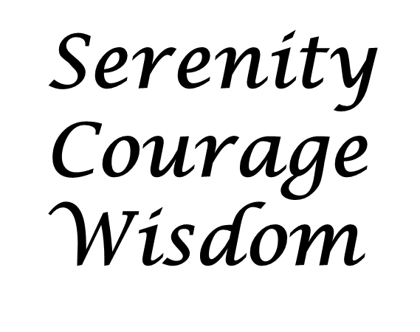
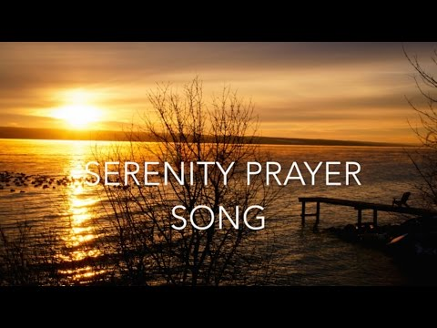

Which word is God speaking to you? Think about that word. What will you do?
Respond
Knowing Norman

Slide 5
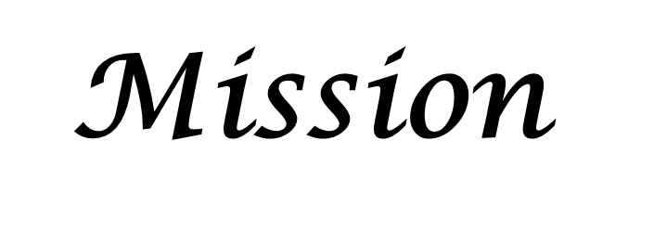
Be all that you can be.
Knowing Norman

Slide 6
Can you create a version for pupils?
Can you create an acrostic verse about one of these words?

