Slide 1


Slide 2


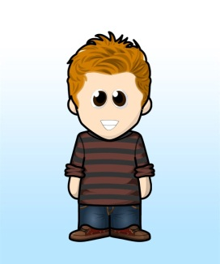
‘Help for others – Eden Gate – Newport Night Shelters
Scripture Link
‘When you ask for help, I’ll be there’ (Matthew 25:31-40) God’s Story p.88
Knowing Norman

Slide 3



‘Help for others – Eden Gate – Newport Night Shelters
Knowing Norman

Slide 4
Eden Gate:
Making a difference in the City of Newport
During the coldest winter months, a group of Newport churches open their doors and hearts to welcome in the city’s homeless from the streets.
We provide a hot supper and drinks, a warm, safe bed for the night, toiletries, breakfast in the morning, and genuine friendship.
Sometimes it may be as simple as lending a listening ear or providing clean, dry clothing.
https://edengate.org.uk/about/

Slide 5

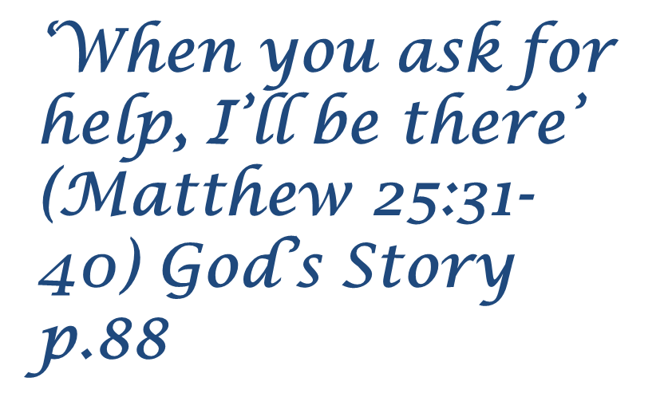


Let us all join our hands. A reading from the Gospel according to John.
All- Glory to You, Oh Lord.
This is the Gospel of the Lord
All- Praise to you Lord Jesus Christ.
Knowing Norman

Slide 6


Who do you want to help? As we listen to the music, place a bead onto the message God is placing in your heart.
homeless
hungry
sick
without clothes
thirsty
Respond
Knowing Norman

Slide 7

Help others
Knowing Norman

Slide 8
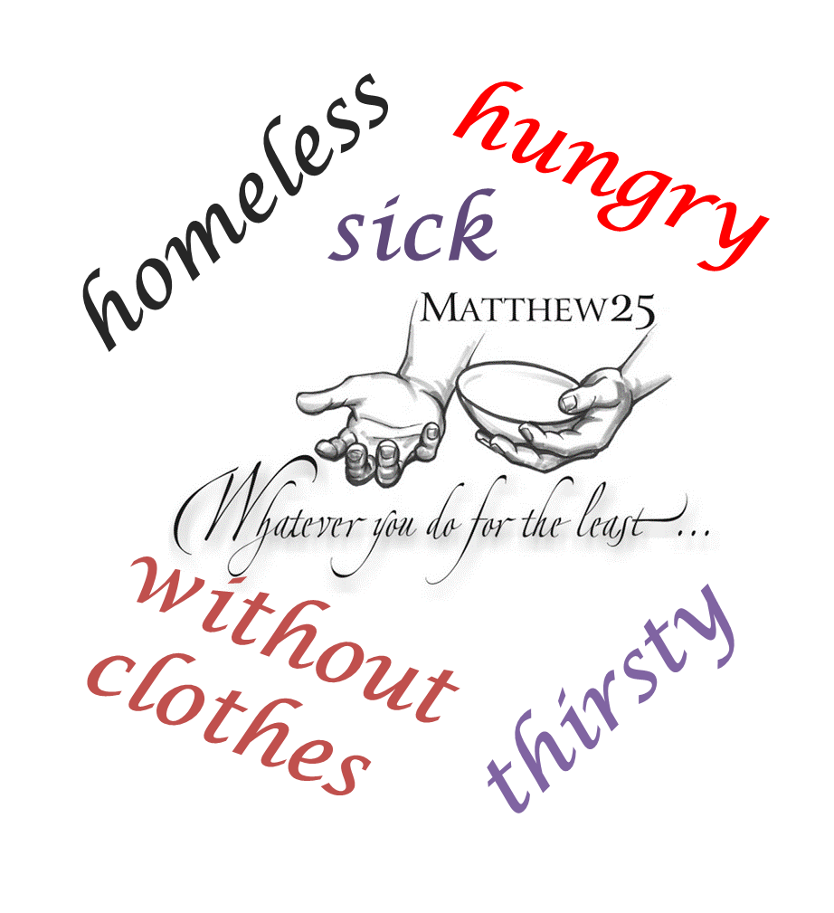
22/03/22
Matthew 25:31-40 and the Newport charity Eden Gate.
In study skills books use resources to explain the work the charity does.
Challenge A one of the things, challenge B two and Challenge C three of the things they do.
Add a poster

