Slide 1
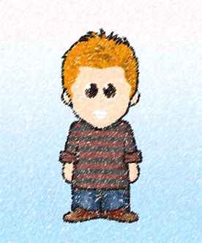

Dewi’s Dream Team – Adventures in St. David’s Primary
Knowing Norman– Eisteddfod? What to do?

Slide 2


Dewi’s Dream Team – Adventures in St. David’s Primary
It was a bright sunny day at the start of Spring. The daffodils were starting to emerge from the ground and it was getting lighter in the evenings.
Norman loved this time of year. It meant he could play football after school with his friends, Cara and Pete. But most of all, it meant the school Eisteddfod was not too far away.

Slide 3
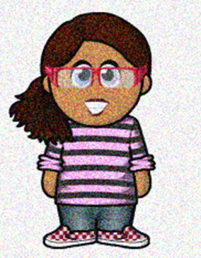
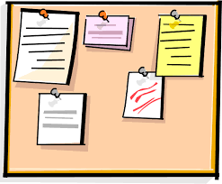
Dewi’s Dream Team – Adventures in St. David’s Primary
Norman ran up to his friends. “Do you know what is happening next week?” he started.
Cate smiled at him. “Yes Norman. The Eisteddfod!”
Norman rushed into class to see what their special Eisteddfod competition was.
On the class notice board, he scanned to find the competition news from Criw Cymraeg. It read:-
This year, you need to make a poster to show how St. David shows us different ways to learn.

Slide 4
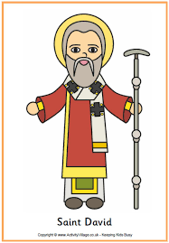
Dewi’s Dream Team – Adventures in St. David’s Primary
“Oh” thought Norman. “That is different.” What could it mean? How can we learn from St. David?
Norman started to wrack his brain. He knew the story of St. David well enough, but what can we learn from him?

Slide 5


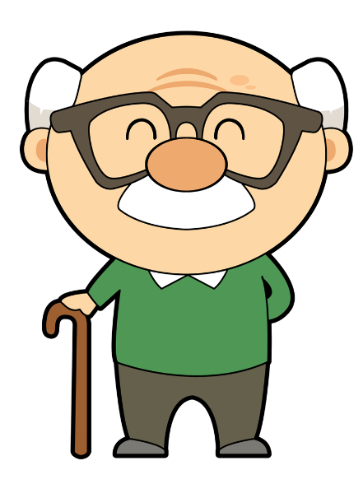
Dewi’s Dream Team – Adventures in St. David’s Primary
So Norman started to find out. He went on the internet to research.
He got some books out from the library.
He talked to his grandad.
But none of that seemed to help.

Slide 6
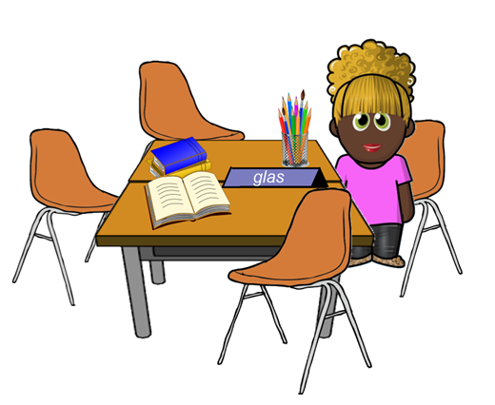

Dewi’s Dream Team – Adventures in St. David’s Primary
So Norman went to ask his friends. What had he learned?
Cara sat down with him and listed all of the things he had found out.
He has persevered, by looking for facts, just like David persevered. He had worked hard, just like St. David. He has listened to others, just like St. David, He had asked for help, just like St. David. He could find things out in lots of different ways by using his hands, studying and listening to his friends.

Slide 7

Dewi’s Dream Team – Adventures in St. David’s Primary
Norman smiled. Now he understood.
He thought of how he could best show what he had learned. A poster? A Google Slide? A talk? A song? As Norman walked back to class he thought. Then he stopped. He knew the perfect way to show what he had learned.
He quickly put his plan into action.

Slide 8

Dewi’s Dream Team – Adventures in St. David’s Primary
The teachers, and the Criw Cymraeg pupils looked at all of the St. David competition entries. They all stopped to look at one entry. He felt very proud as they announced….
“The Eisteddfod winner is…..Cara.
Norman had made sure Cara had put down all the things she had told him. She really understood and knew how to be a learner like St. David!!!

Slide 9

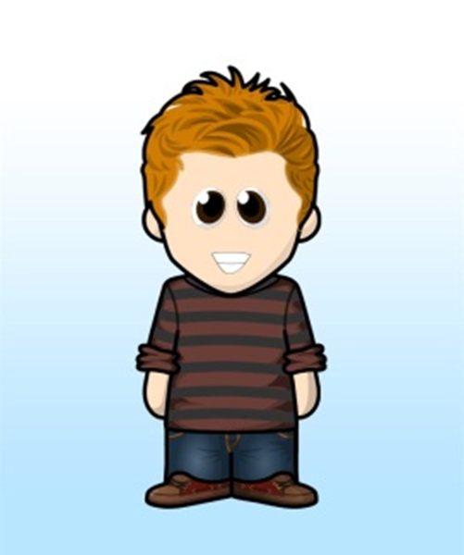

Show you can learn like St. David!

Slide 10
Task -
St. David’s famous quote is ‘Be joyful and keep the faith. Do the little things well.’
So just like Norman and Cate and Cara, can you explain how St. David shows us different ways to learn.

