Slide 1
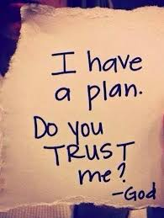
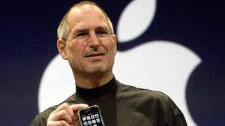
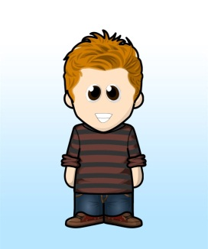
Scripture Link
Once you get there, you can move mountains – Steve Jobs
‘God loves you, trust in God’s plan (Matthew 6:24-31)
Knowing Norman

Slide 2

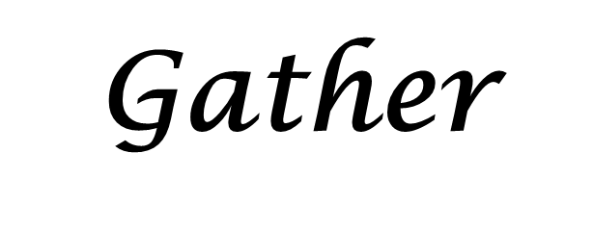
Once you get there, you can move mountains – Steve Jobs
Knowing Norman

Slide 3
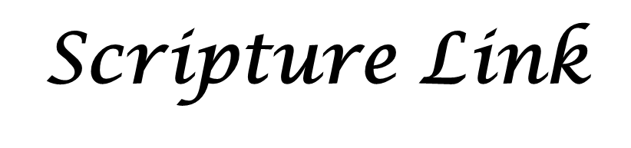

‘God loves you, trust in God’s plan (Matthew 6:2,4-11)
Knowing Norman

Slide 4

Place a pebble on the altar, we are ‘moving the mountain’ – one pebble at a time.
Respond
Knowing Norman

Slide 5
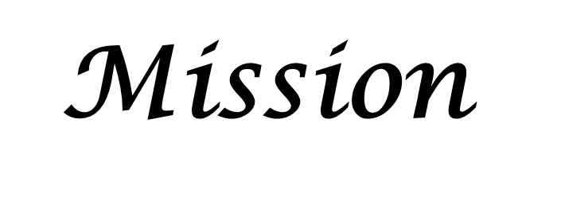
Once you get there, you can move mountains
Knowing Norman

