Slide 1
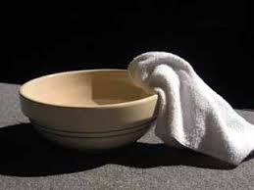

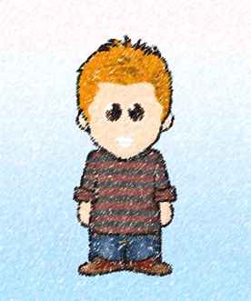
Helping others
Scripture Link
‘Washing their feet’ – (John 13:4-9, 12-15 God’s Story 3 p.115)
Knowing Norman

Slide 2
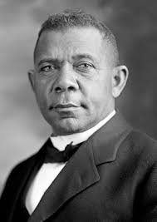

If you want to lift yourself up, lift up someone else. -Booker T Washington
https://kids.nationalgeographic.com/history/article/booker-t-washington
Knowing Norman

Slide 3

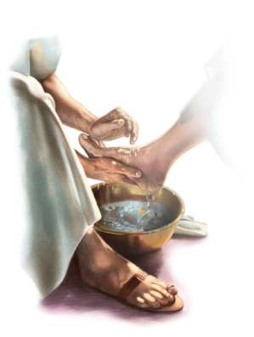

Washing their feet’ – (John 13:4-9, 12-15 God’s Story 3 p.115)
Let us join our hands as we read God’s Words.
A reading from the Gospel according to John.
All- Glory to You, Oh Lord.
This is the Gospel of the Lord
All- Praise to you Lord Jesus Christ.
Knowing Norman

Slide 4

Jesus wants you to be like him, to care and look after each other, just like he looks after you. What will you choose to do?
Respond

Slide 5

Follow Jesus’ example
Knowing Norman

Slide 6

What will you do for others?

