Slide 1

Dewi’s Dream Team – Adventures in St. David’s Primary
Connecting Cate – The School Trip

Slide 2

Dewi’s Dream Team – Adventures in St. David’s Primary
It was an exciting day. All of Cate’s class were happily talking in the playground, waiting to go into school.
Today was the day of their trip to the zoo. The first school trip since COVID! They were going to spend the morning going around the animal areas. But best of all, one group would get to spend the afternoon working as mini zoo- keepers!
Cate and her friends were bursting with excitement.

Slide 3
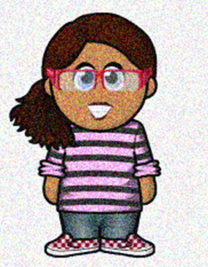

Dewi’s Dream Team – Adventures in St. David’s Primary
The bell went and Cate’s class were eager to get into class. Their teacher, Mrs. Williams was waiting for them.
“Children, as you know, there is a special treat for one lucky group today.” she said.
Cate smiled at her friends – she was sure she would be chosen!
“We will have a special zoo quiz sheet – the children who find out most about the animals will get to spend the afternoon as mini zookeepers.” Mrs. Williams added.

Slide 4

Dewi’s Dream Team – Adventures in St. David’s Primary
“Oh” thought Cate. She wasn’t very good at quizzes outside of school. Where would she find the answers?
She sat down with a sigh. As she looked out of the window, she saw her grandmother’s car leaving the car park. They had been visiting from India this month and her grandmother had been bringing her to school.

Slide 5

Dewi’s Dream Team – Adventures in St. David’s Primary
She sat up and smiled as she remembered her grandmother’s word to her.
“ You can achieve anything if you try – always look to see where you can get help or find answers.”
Cate knew what to do. When the bus picked them up, she was happily talking to her friends.

Slide 6

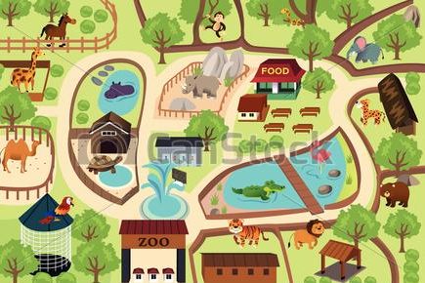
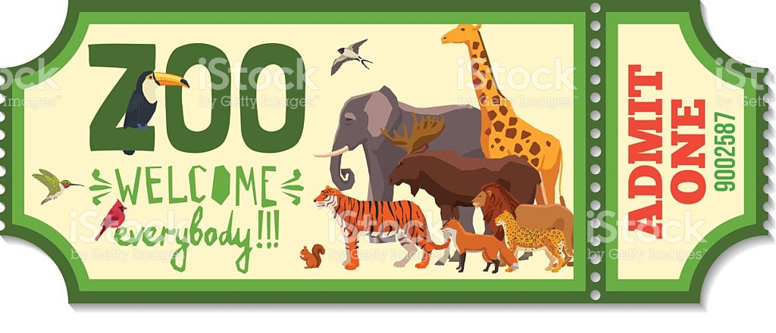
Dewi’s Dream Team – Adventures in St. David’s Primary
Soon they arrived at the zoo. Mrs. Williams gave the children a plan of the zoo. Cate studied it carefully and made her plan.
Her friends made plans to see their favourite animals – but not Cate. On her map, she drew out directions and a timetable of everything she wanted to see and do.

Slide 7
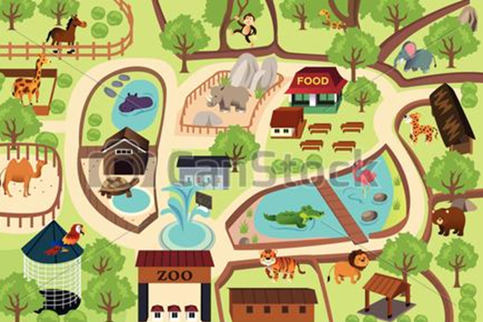
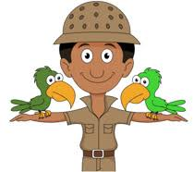
Dewi’s Dream Team – Adventures in St. David’s Primary
Quickly, Cate put her plan into action.
She went around the interactive displays, finding out as much information as she could.
She avoided the play areas, and went to each of the ‘keeper talks’ in the morning.
Using the information, she made quick notes to help her. After lunch, Mrs. Williams gave out the quiz sheets and gave the children 10 minutes to answer them.

Slide 8

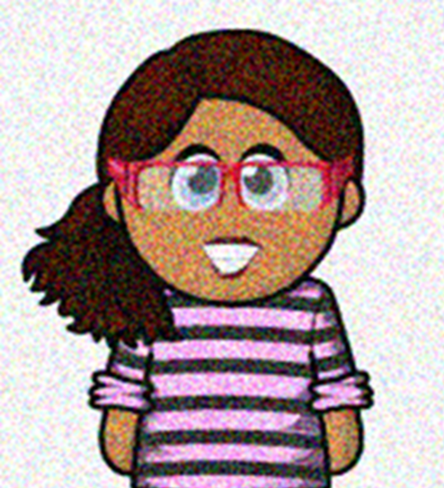
Dewi’s Dream Team – Adventures in St. David’s Primary
The zoo keepers quickly went over the answers and gave the quizzes back to Mrs. Williams. She announced the winners. Cate listened carefully for her name. “ And finally the pupil with the most points and chief mini zookeeper for today is…….
Cate!” All her friends clapped and cheered. Cate smiled – her connecting plan had worked!

