Slide 1
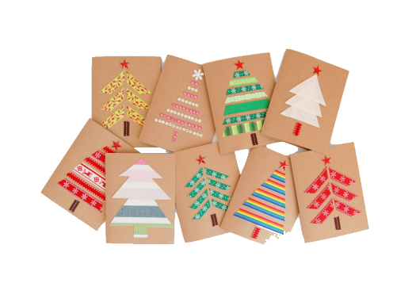
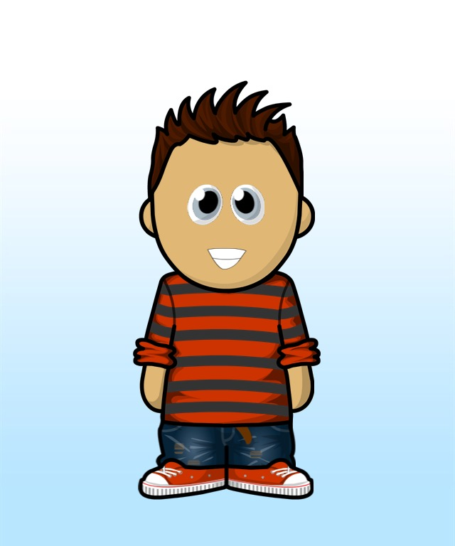
Perseverance Pete – The Christmas Card Crisis

Slide 2

Mrs. Phillips came in to class at the end of the day, carrying a pile of letters that needed to go home.
“Cate, Pete, can you hand out these letters please?”
Pete jumped up eagerly, until he saw what the letter was.

Slide 3
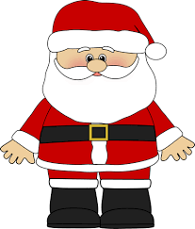
Pete sighed. Every year the school had a special assembly. All the children had to design a special Christmas Card to give to Santa. They could be big, colourful, 3D or musical.
All of the school gathered in the hall to show off their designs and the winners from each class would win a special prize at the school disco from Santa, and hand over their winning designs.

Slide 4


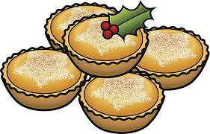
As he gave out the letters, he could hear the other children excitedly talking about their designs.
This year I’m going to record myself singing and add it as a QR code!
“Mine is going to have real mince pies stuck to the front!”,replied Norman.

Slide 5


All of his friends were happy, but Pete felt down in the dumps. Every year he tried his best with the competition, but he had never even made it to the top three.
As he went around he quietly crumpled up his own letter and dropped it in the bin.

Slide 6
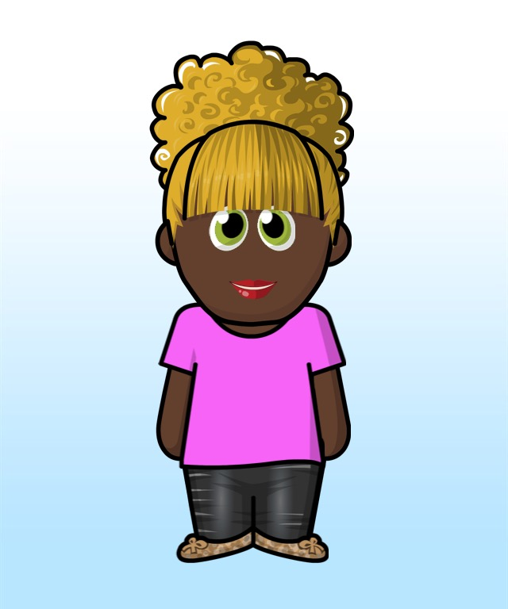
On the weekend, Cara came over. “Hi, Pete, I’ve started my card, what are you doing?”
“Nothing.” he replied and sat down with a tear in his eye.
“What is wrong?” asked Cara.

Slide 7
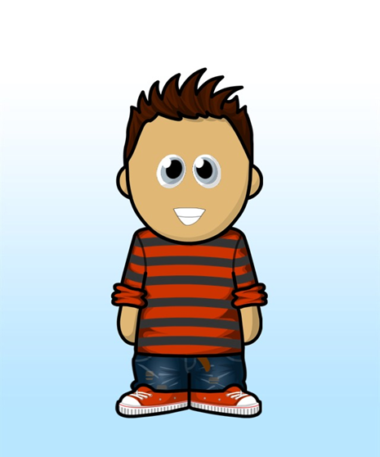
So Pete explained.
When he finished, Cara looked at him and smiled.
“Well this year is going to be different because we are going to make one together. What are your favourite parts of Christmas?”

Slide 8

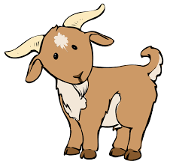
So they made a list – spending time with family, the excitement of waiting for the birth of Jesus, Carols, the Christmas lights, going to visit Great Aunt Lynn in the countryside every year and feeding her goats.
The list went on and on.

Slide 9

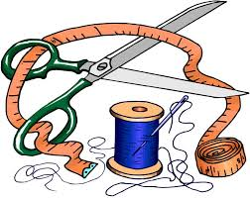
‘Right’, said Cara, ‘Lets put them all in the card.’
And so they started. They had lots of ideas and put lots of things into the card. It was taller than Pete when they finished, and looked a bit messy.
He didn’t think it would win, but he didn’t really care. He had enjoyed making it and not giving up. He realized the fun and the challenge was in creating the ideas – not if he won.

Slide 10

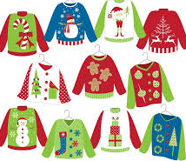
The day of the card assembly arrived. All the children were excited – Christmas was just around the corner and Mr. Williams was wearing his best Santa boots.
Some of the teachers were dressed as reindeers and all the children had Christmas jumpers on. It was a magical day.

Slide 11

Pete’s class was waiting their turn, cheering on the others, and picking their favourites with their friends.
He was having so much fun, he forgot all about winning. Cara winked at him. ‘Ready Pete?’ He smiled back. His card was so big, one of the teachers had to help him carry it around.
‘Well done’ Mrs Phillips smiled.

Slide 12



And the winner is………..
But Pete wasn’t listening. He knew he was a winner, because he had tried his best and that was all that really mattered.

