Slide 1
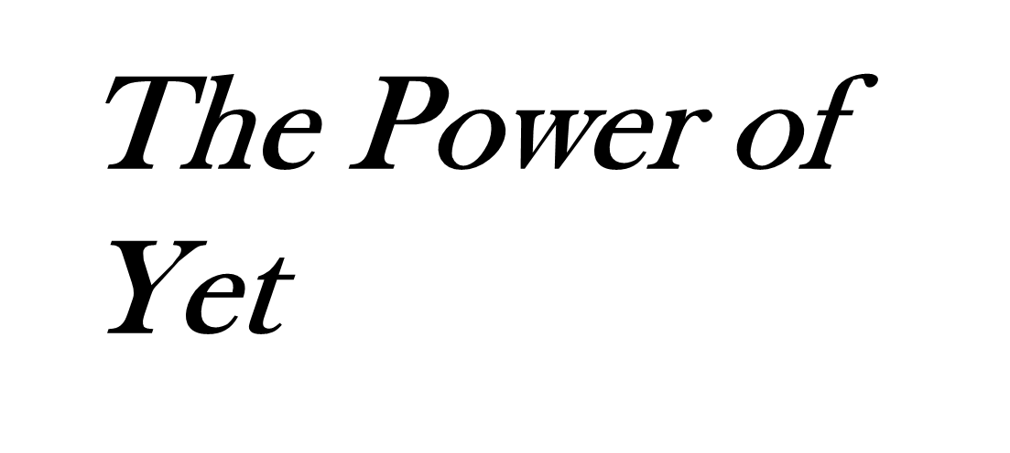
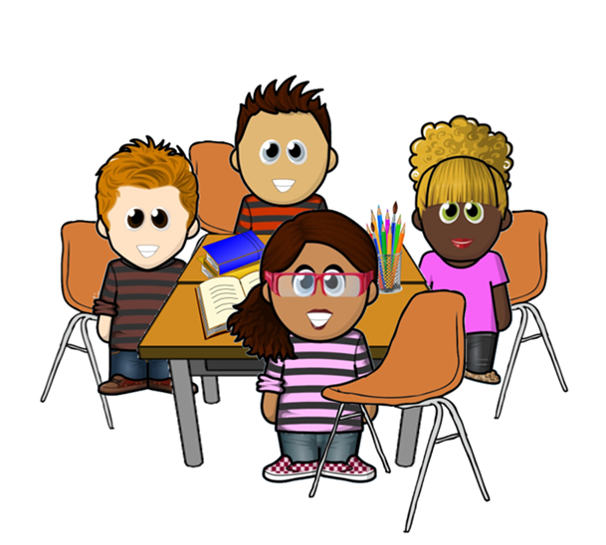
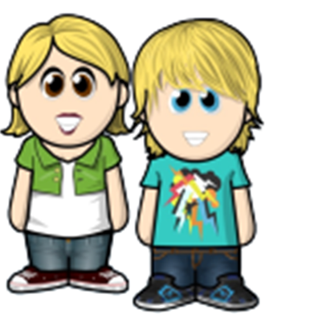
Dewi’s Dream Team – Adventures in St. David’s Primary

Slide 2

Dewi’s Dream Team – Adventures in St. David’s Primary
The bell rang and the friends excitedly made their way into class.
They had not seen much of each other over the Summer holiday and were looking forward to a new school year. They were anxious to share all the different things they had done in the six weeks.

Slide 3
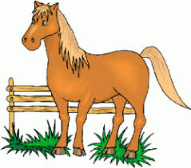
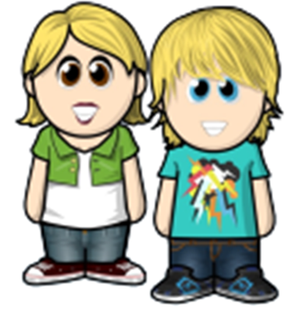
After putting away their bags and coats, they began asking each other what they had done and where they had been.
Aled and Anya had visited their Uncle in the Brecon Beacons.
We had a great time. We learned to ride a horse on Uncle Aaron’s farm.

Slide 4

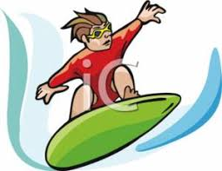
Cate thought that sounded like great fun. She had always wanted to ride a horse but thought it sounded tricky. She had gone to Cornwall and had learned to body board with her big sister.

Slide 5
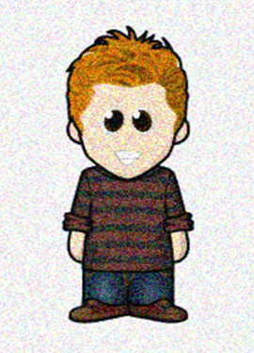
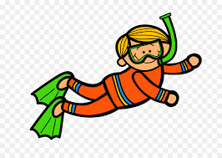
“I wish I could body board”, thought Norman. “That sounds cool, but I bet it is really hard to learn. I bet I would just keep falling off.”
Norman had spent a week in Spain with his Mum and Dad. They went to a water park and he had learned how to scuba dive.
‹#›

Slide 6
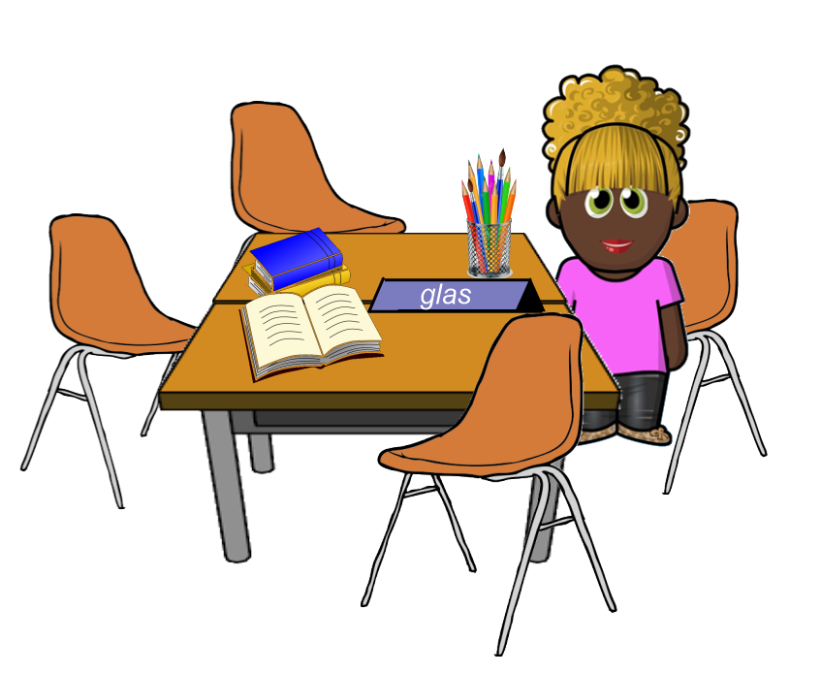

Cara was SO jealous. She had always wanted to try that.
You are very lucky Norman!
Cara had spent the holidays at home. Mostly at Gran’s as Mum was busy at work and couldn’t get time off. Gran had taught her how to knit and she had made all her friends special jumpers for the new term.
‹#›

Slide 7
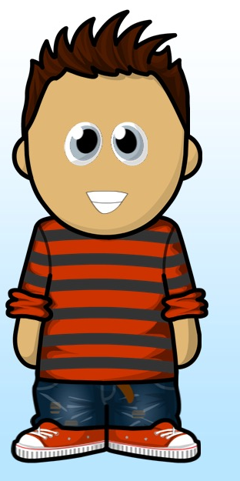

Pete thought his new jumper was amazing. He knew he would never be able to make something like that. His friend Cara was so talented.
Pete had gone to football camp whilst his step Dad and Mum were decorating the house. He had learned loads of tricks and had moved from Newland Stars C to Newland Stars A. What’s more he had scored his first hat trick on Saturday!

Slide 8
Miss Williams, the TA in the class smiled as she heard them talking. “Look at all the new things you have learned this summer!”, she told them.
“Don’t say you can’t do it, remember – I can’t do it YET.”
What will you achieve this year with the Power of Yet?
The friends smiled – of course The Power of YET.
We can’t do it YET. But if we keep trying, we will succeed!

Slide 9
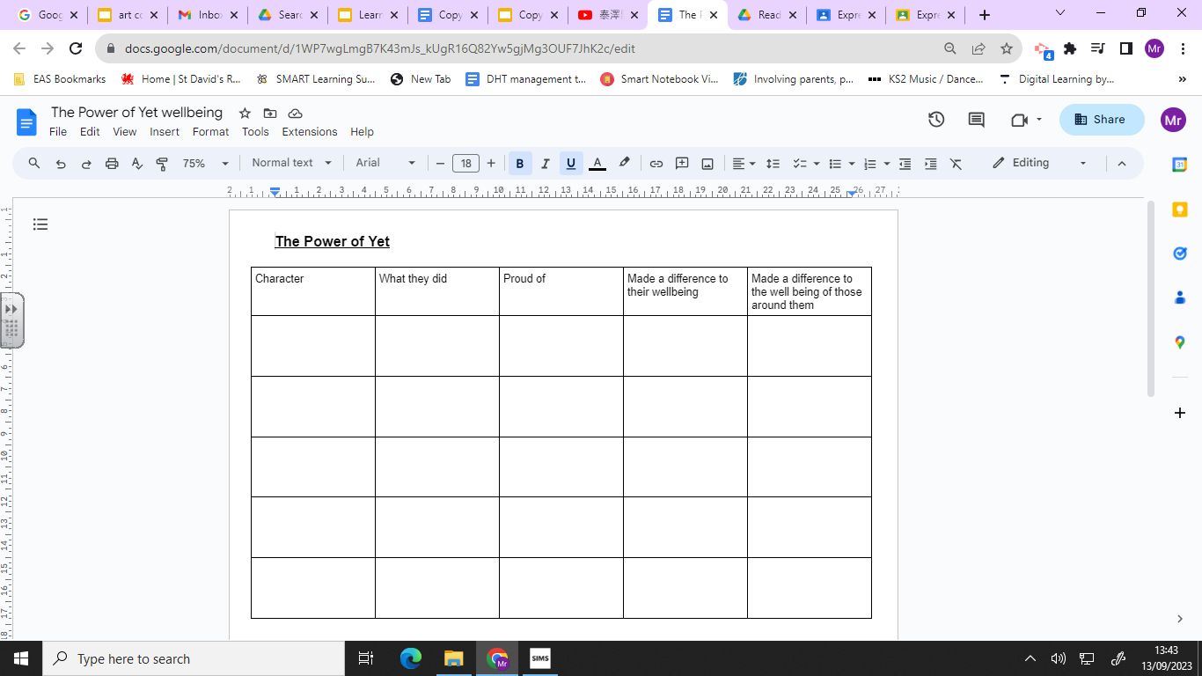

Slide 10


