Slide 1
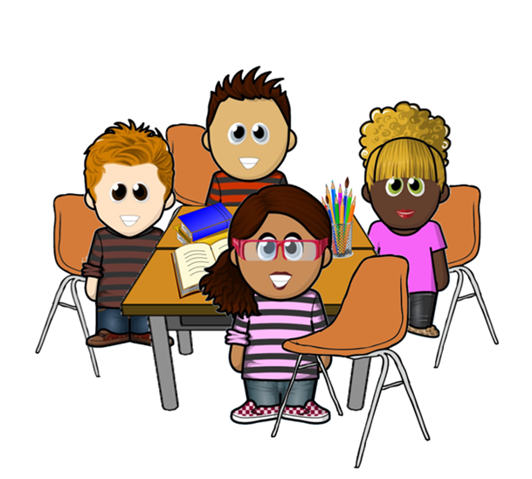

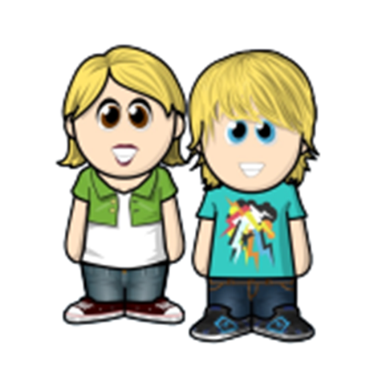
Say Hello to Dewi’s Dream Team

Slide 2
The Power of Yet…
Our friends begin the year wishing they had each others’ talents and gifts.
In the story ‘The Power of Yet’, they realise it is just they can’t do it yet. If they keep trying, they will succeed!

Slide 3
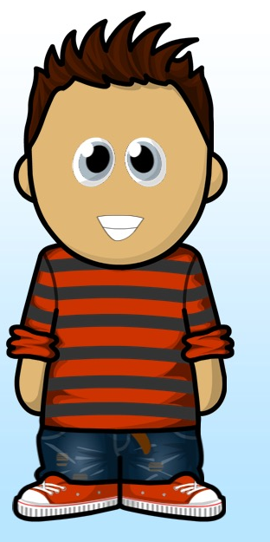
Perseverance Pete
Pete sometimes finds things hard, but he doesn’t give up, he perseveres.
In the story ‘The Christmas Card Crisis’, Pete didn’t know what card design he was going to make for the school competition - but he persevered (and had a lot of fun!)

Slide 4
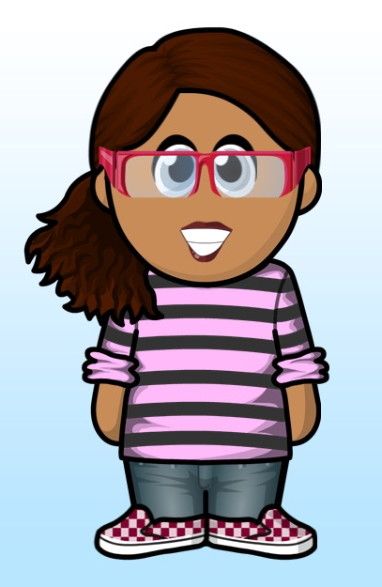
Connecting Cate
Cate is good at making links between things, which helps her learning.
In the story ‘The School Trip’, Cate wanted to win a competition to be a zoo keeper for a day, so she linked together all the fun animals facts she found out in the zoo and won the prize!

Slide 5
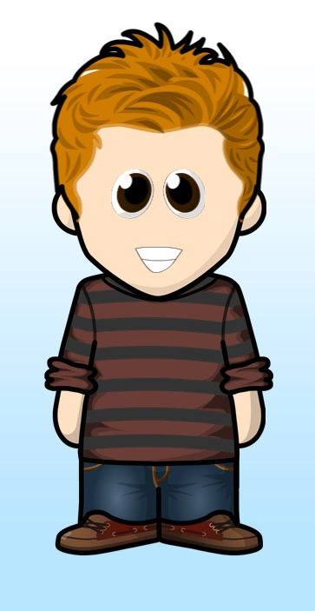
Knowing Norman
Norman knows how to use resources and other people to help him. He may not always know the answer at first, but he can research on the internet, in books and by asking friends, family and teachers to get the answer. In the story ‘The Eisteddfod’, he did that to help his friend Cara win first prize! What a good friend he is!!

Slide 6
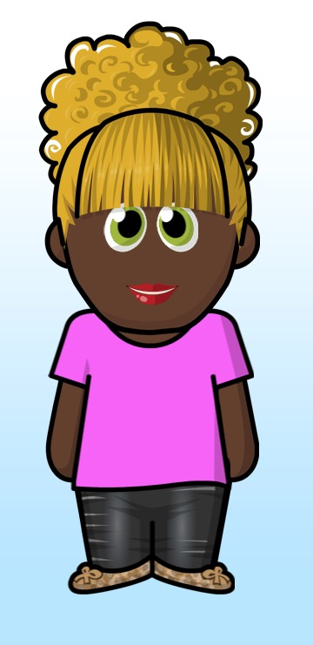
Collaboration Cara
Cara loves to work as a team. She is helpful and kind and supports her friends.
In the story ‘The PPTA Stall’, Cara was reminded how important teamwork is (and how important good friends are!)

Slide 7
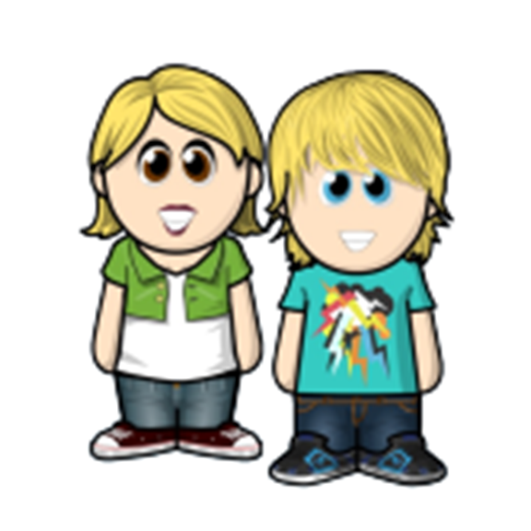
Achievement Twins - Aled and Anya
Aled and Anya enjoy celebrating the success of their friends.
They are inspired by others. In the story ‘Prize Day’, they remind everyone you are only really ever competing against yourself to be the best you can be.

Slide 8
Who do you think you will be like today?

