Slide 1
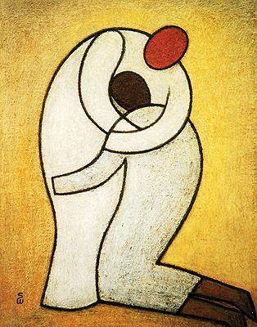



Scripture Link
We are Family – Barnardo’s
‘God loves His family’
(Luke 15:11-32)
Connecting Cate

Slide 2

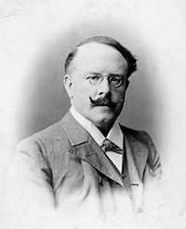

We are Family – Barnardo’s
Connecting Cate

Slide 3


‘The Prodigal Son’
(Luke 15:11-32)
Connecting Cate

Slide 4
Close your eyes– think how you will make a difference to God’s family today?
God loves His family’
(Luke 15:11-32)
Respond

Slide 5


Loving God ‘s family – making a difference like Jesus and Barnardo
Connecting Cate

Slide 6
Scripture Link
We are Family – Barnardo’s
‘God loves His family’
(Luke 15:11-32)
Connecting Cate

