Slide 1

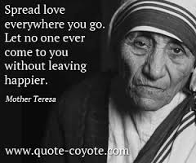
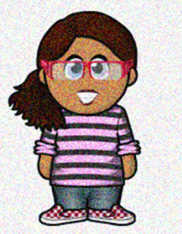
Scripture Link
Helping each other – Mother Teresa
‘With God’s help’
(Luke 10:25-37)
Connecting Cate

Slide 2

Helping each other – Mother Teresa
Connecting Cate

Slide 3



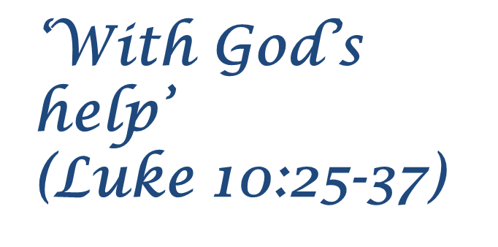
Connecting Cate

Slide 4
Place a pebble on the altar – think how you will make someone smile today.
Respond

Slide 5

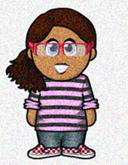
Helping each other
Connecting Cate

Slide 6
Scripture Link
Helping each other – Mother Teresa
‘With God’s help’
(Luke 10:25-37)
Connecting Cate

